Slide 1

Hobo (health optimisation robot)

Slide 2








Correct Time
Correct person
Correct dosage
!
Error prone
Manual
Labour intensive

Slide 3
Our user storyboard
3 MACHINES, 1 SYSTEM

Slide 4
Our user storyboard
3 MACHINES, 1 SYSTEM
PHOBO
HOMEBO
ELBO
Notes:
Introduce the 3 machines, general overview of their functionality

Slide 5
Cuts and dispenses each medicine into a compartment
PHOBO
HOMEBO
ELBO
3 MACHINES, 1 SYSTEM

Slide 6
Cuts and dispenses each medicine into a compartment
Auto sorting & dispensing mechanism, equipped with buzzer alert feature
PHOBO
HOMEBO
ELBO
3 MACHINES, 1 SYSTEM

Slide 7
Auto sorting & dispensing mechanism, equipped with buzzer alert feature
Alert feature, authentication and locking mechanism
PHOBO
HOMEBO
ELBO
3 MACHINES, 1 SYSTEM

Slide 8



Pharmacy
Home
ElderCare
Our user storyboard

Slide 9
Pharmacy
Home
ElderCare
Our user storyboard
Notes:
One complete solution that targets the entire process – from pharmacy to home to eldercare

Slide 10
Loratadine 1 dose/day ✓
Ibuprofen 3 doses/day ✓
Doctor
Notes:
Doctor prescribes medicine & keys the prescription into the app

Slide 11

Loratadine 1 dose/day ✓
Ibuprofen 3 doses/day ✓
Doctor
Pharmacist

Slide 12




PHOBO
Loratadine 1 dose/day ✓
Ibuprofen 3 doses/day ✓
Doctor
Pharmacist

Slide 13
PHOBO
Loratadine 1 dose/day ✓
Ibuprofen 3 doses/day ✓
Doctor
Pharmacist
Notes:
Pharmacist will collect all the medicine needed and use PHOBO to cut the blister pack into individual pills

Slide 14

Notes:
Pills will be sorted into individual compartments of a cartridge

Slide 15

Pharmacy
Household

Slide 16
Pharmacy
Household

Slide 17


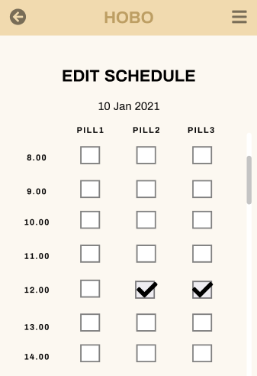

HOMEBO
Notes:
The cartridge will be inserted into HOMEBO. Family member will program medicine intake schedule based on doctor prescription.

Slide 18

HOMEBO
Notes:
Right time to eat, alert

Slide 19
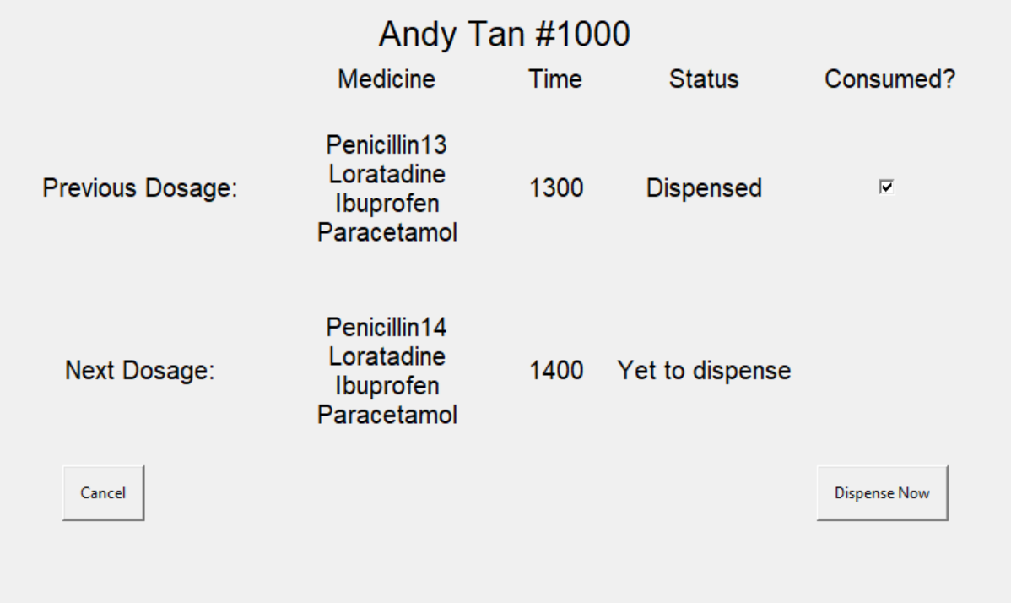
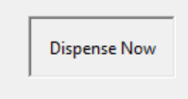
HOMEBO
Notes:
Acknowledge alert

Slide 20
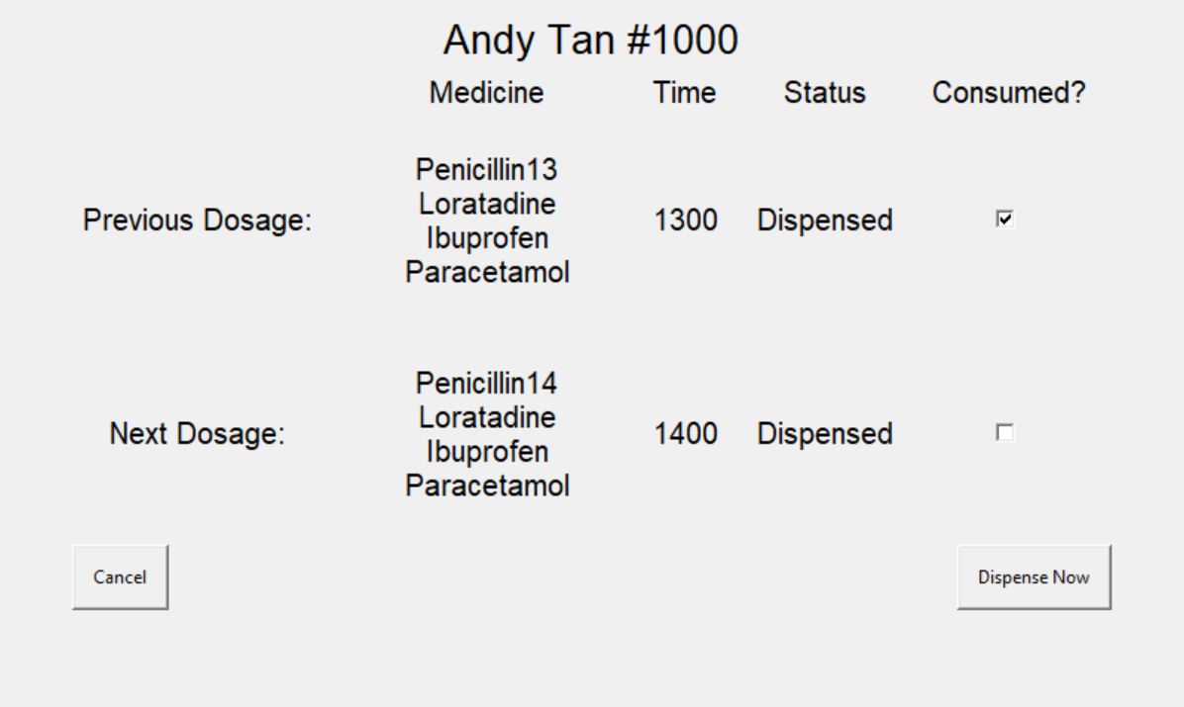
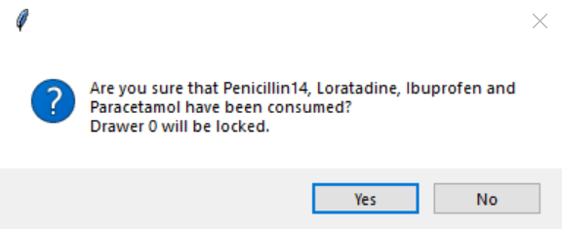
HOMEBO
Notes:
Dispense

Slide 21

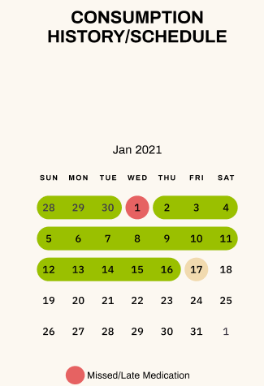
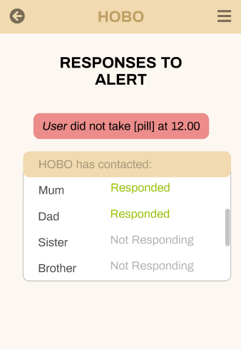
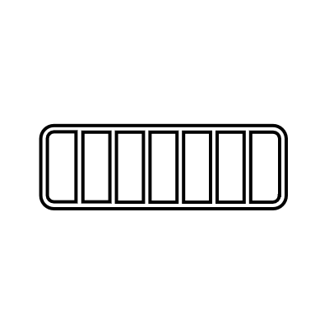


HOMEBO
Notes:
If never take on time, alert family members. For eldercare patients, HOMEBO will automatically refill pill boxes

Slide 22
ElderCare
Household
HOMEBO
Notes:
Which will be brought over to the eldercare centre

Slide 23
ElderCare
Household

Slide 24


ELBO
Notes:
Patients bring pillboxes to eldercare centre, pass to caregivers. Caregivers insert pillbox to corresponding drawer. While setting up machine, patient id required so caregivers can link the correct pillboxes to correct drawer (Right person)

Slide 25

ELBO
Notes:
Drawer locked. Time to eat, app alert, light alert. (Right time).

Slide 26
ELBO

Slide 27
ELBO

Slide 28

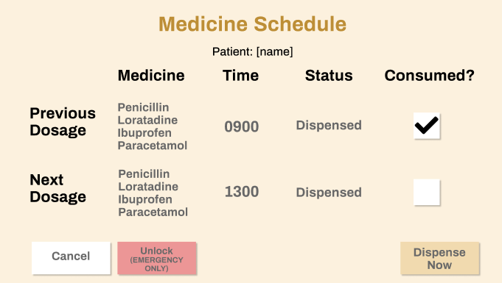

ELBO
Notes:
Qrcode for authentication purposes. Caregivers can cross check medication & picture of dosage before dispensing (right dose). Dispense already -> Drawer unlocked

Slide 29
ELBO
Notes:
Caregiver will pass pillbox to patient, visual confirmation that patient has eaten the medication

Slide 30
ELBO
Notes:
Final confirmation that dosage eaten -> Verify -> Drawer locked

Slide 31
ELBO

Slide 32
ELBO
Notes:
If late, more and more app notifications progressively sent to more and more people, such as other caregivers and managers
Consumption schedule of all patients ready available on HOBO app, caregiver manager can see, family members can also see

Slide 33
Our progress so far

Slide 34
Our progress so far

Slide 35




Software
framework
storyboard
Machine &
ui design
Elbo mechanisms
Notes:
Locking mechanism, planned out software framework for app, backend etc.

Slide 36



Software
framework
storyboard
Machine &
ui design
Elbo mechanisms
Notes:
Tab out show pictures of UI, rendered pictures

Slide 37
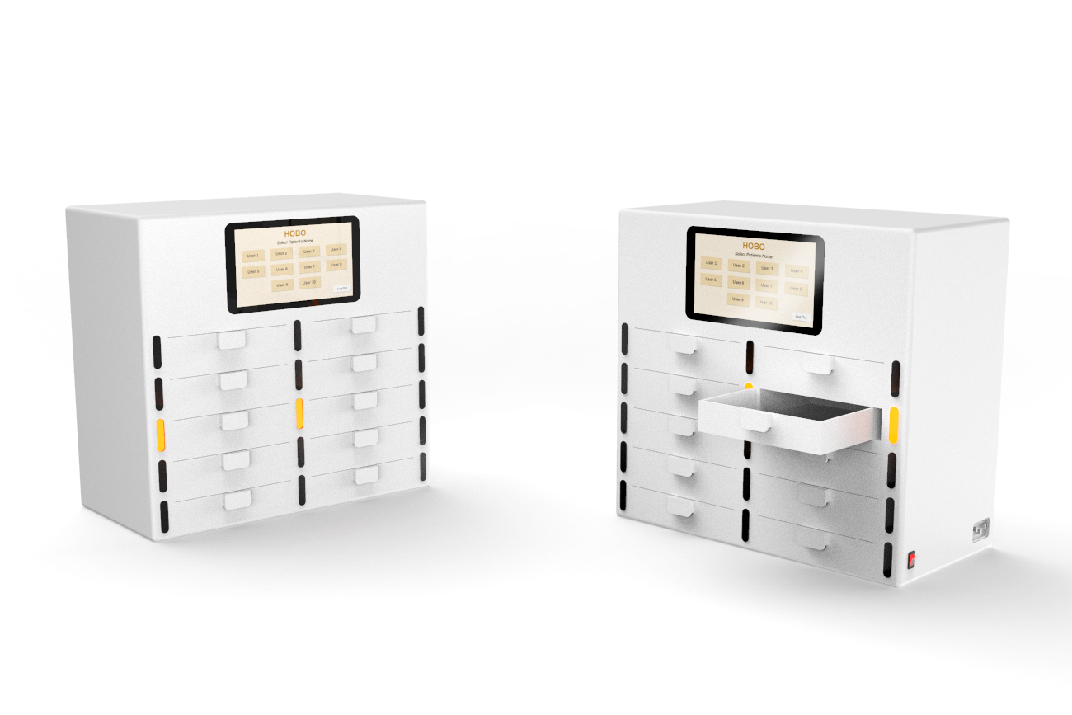
Machine &
ui design

Slide 38

Any questions for us?

